Slide 1

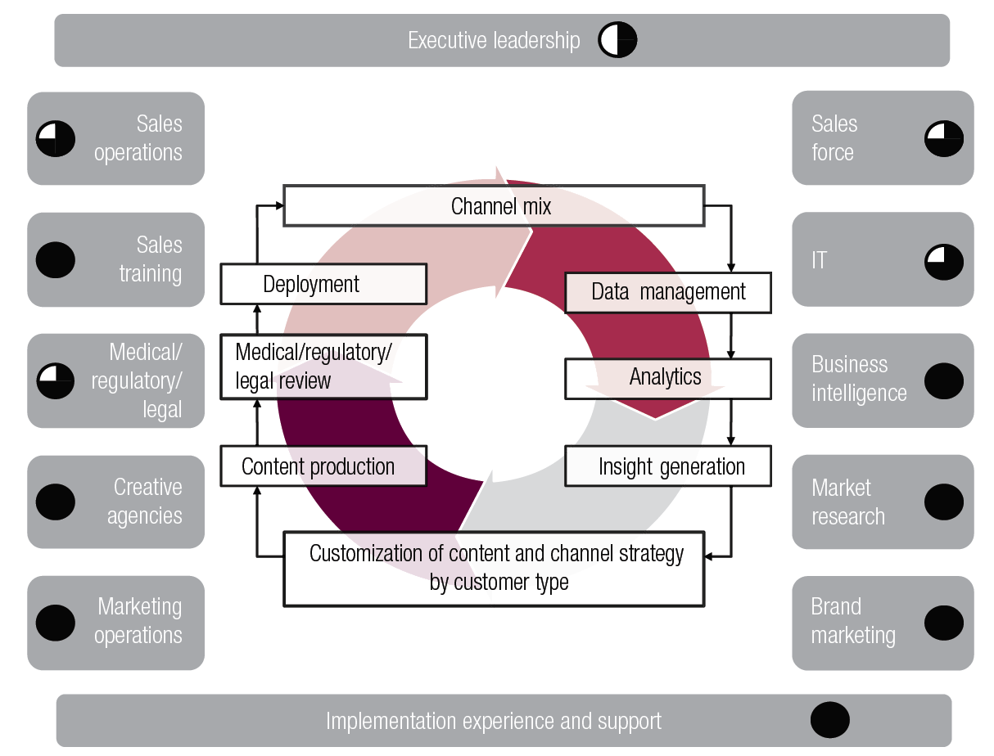
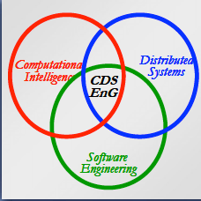
Smart Sales in Pharmacy:
Solution for CLM(closed loop marketing) in CDS
by
Xinyu Yun
- Project Presentation
ECE9607 - Xinyu Yun

Slide 2
Project Description & Motivation
CLM key “pillars”
- personalization/customization, Analytics, and responsiveness
Functionally
- analysis and design to propose features on how to ‘close the loop’ in CRM system.
Technically
- interaction protocol design and implementation on open platform with privacy concerns
ECE9607 - Xinyu Yun

Slide 3
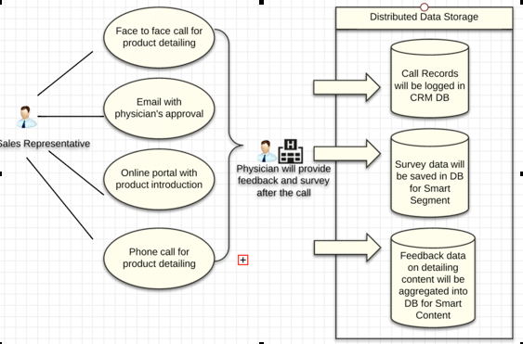
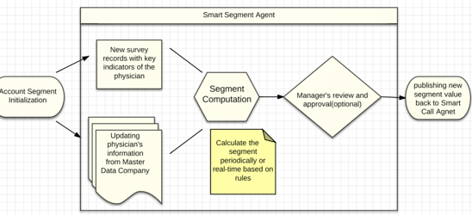
Technical Issues and Analysis - Scenario
Firstly, the knowledge and behavior for each “smart object” should be identified and designed.
Secondly, the interaction and communication protocols between “smart objects” should be defined due to the business scenarios and technical platform we have chosen.
On the other hand, the privacy issue will be addressed during the interaction implementation.
ECE9607 - Xinyu Yun

Slide 4
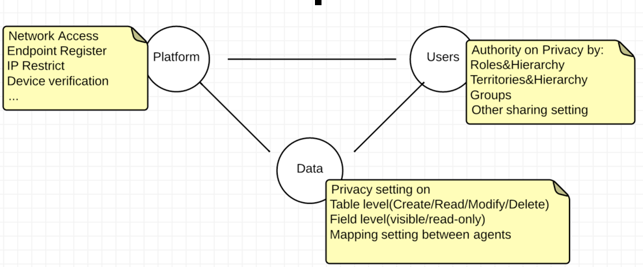
Technical Issues and Analysis - Privacy Concerns
Access control through trusted brokering layer to avoid privacy violation
User authority configuration categorized by different roles, territories, or groups to define the boundary of behavior in ‘smart object’
Data privacy policy in multiple level:
Table level – define if operations (Create/Delete/Modify/Read) the user can do to the table.
Field level – define if the user can view or change this field and its data.
Mapping Setting – define which field will be shared to between ‘smart objects’.
ECE9607 - Xinyu Yun

Slide 5
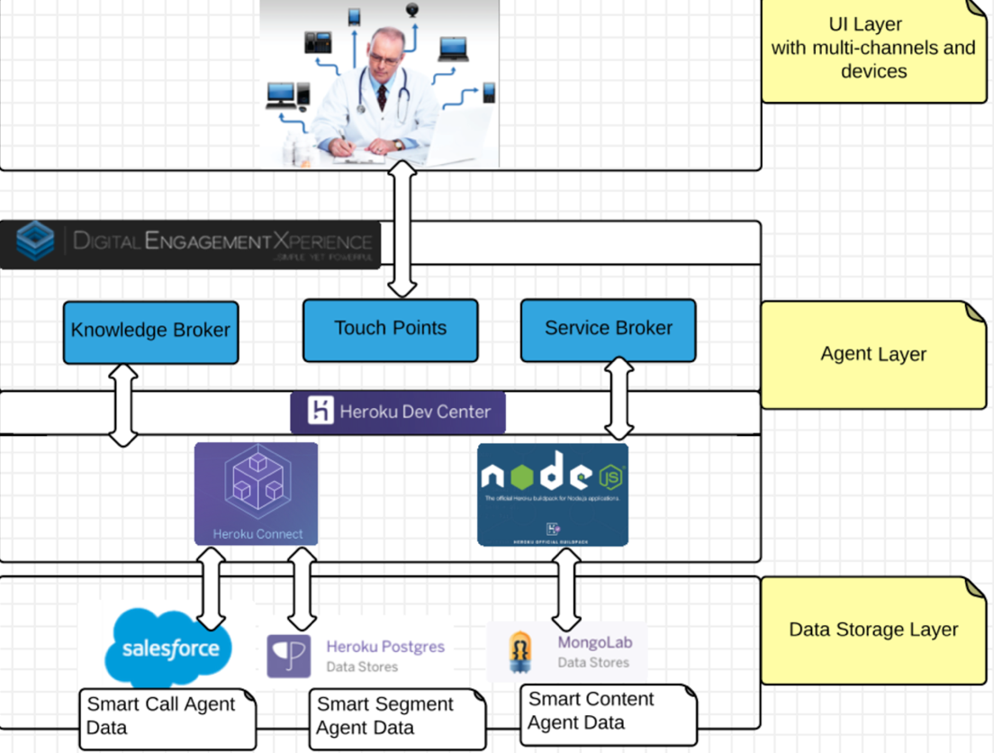
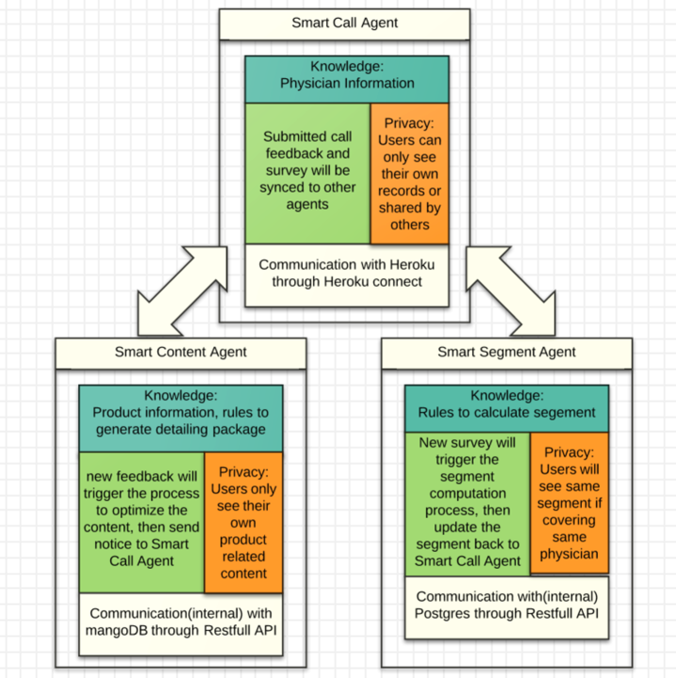
Proposed Solution - Architecture
Typical three layers logical architecture
Deployed to open environment to simulate “smart object”
ECE9607 - Xinyu Yun

Slide 6

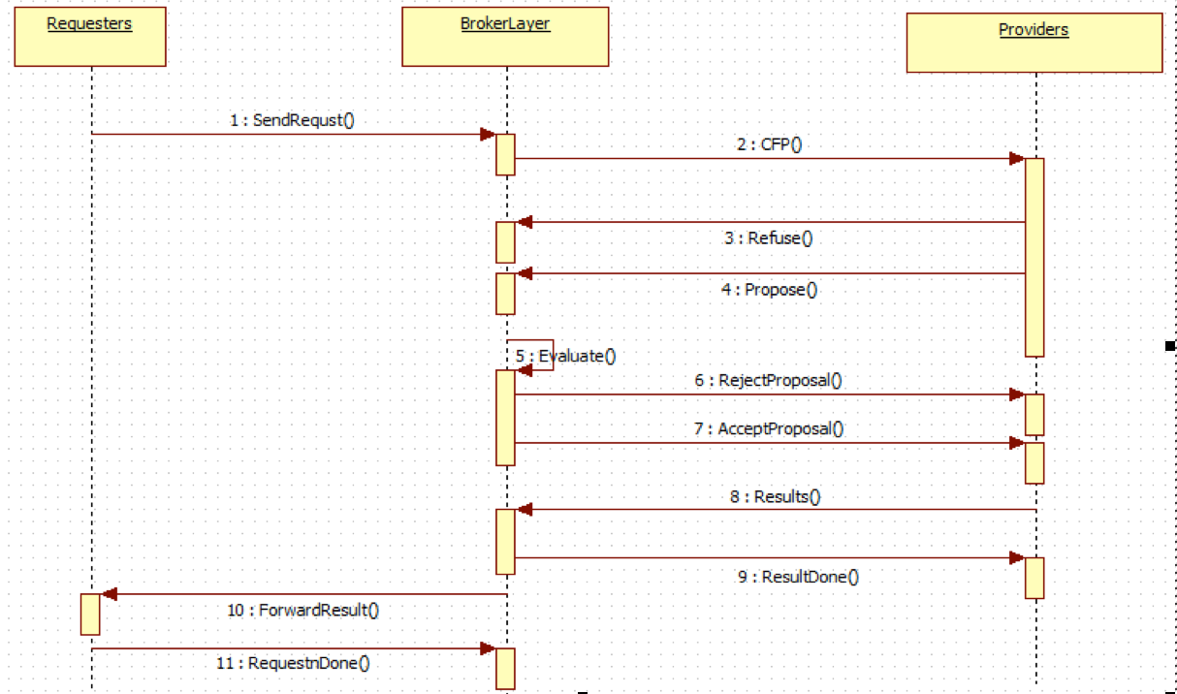
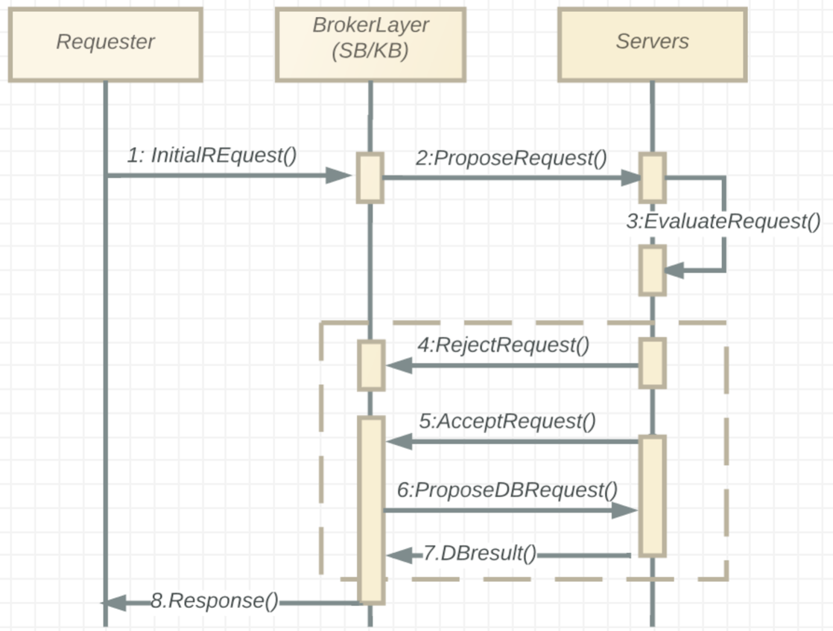
Proposed Solution - Interaction Protocol
Negotiation protocol with potential providers
Protocol between two “smart objects”
ECE9607 - Xinyu Yun

Slide 7
Result and Validation
Storage Layer- Data will be saved in different cloud platforms(Heroku & Salesforce), DB will be registered in Knowledge Broker for further operations.
Processing Layer - Services implemented by node.js will be deployed to Heroku, and registered in Service Broker for requestor’s calling.
UI and Requestor - End user will gather data and start request from salesforce to other ‘smart object’, the results offered by problem solver will be synced back through ‘Heroku Connect’
Privacy concerns will be handle by salesforce security&privacy features and data mapping setting from ‘Heroku Connect’
ECE9607 - Xinyu Yun

Slide 8
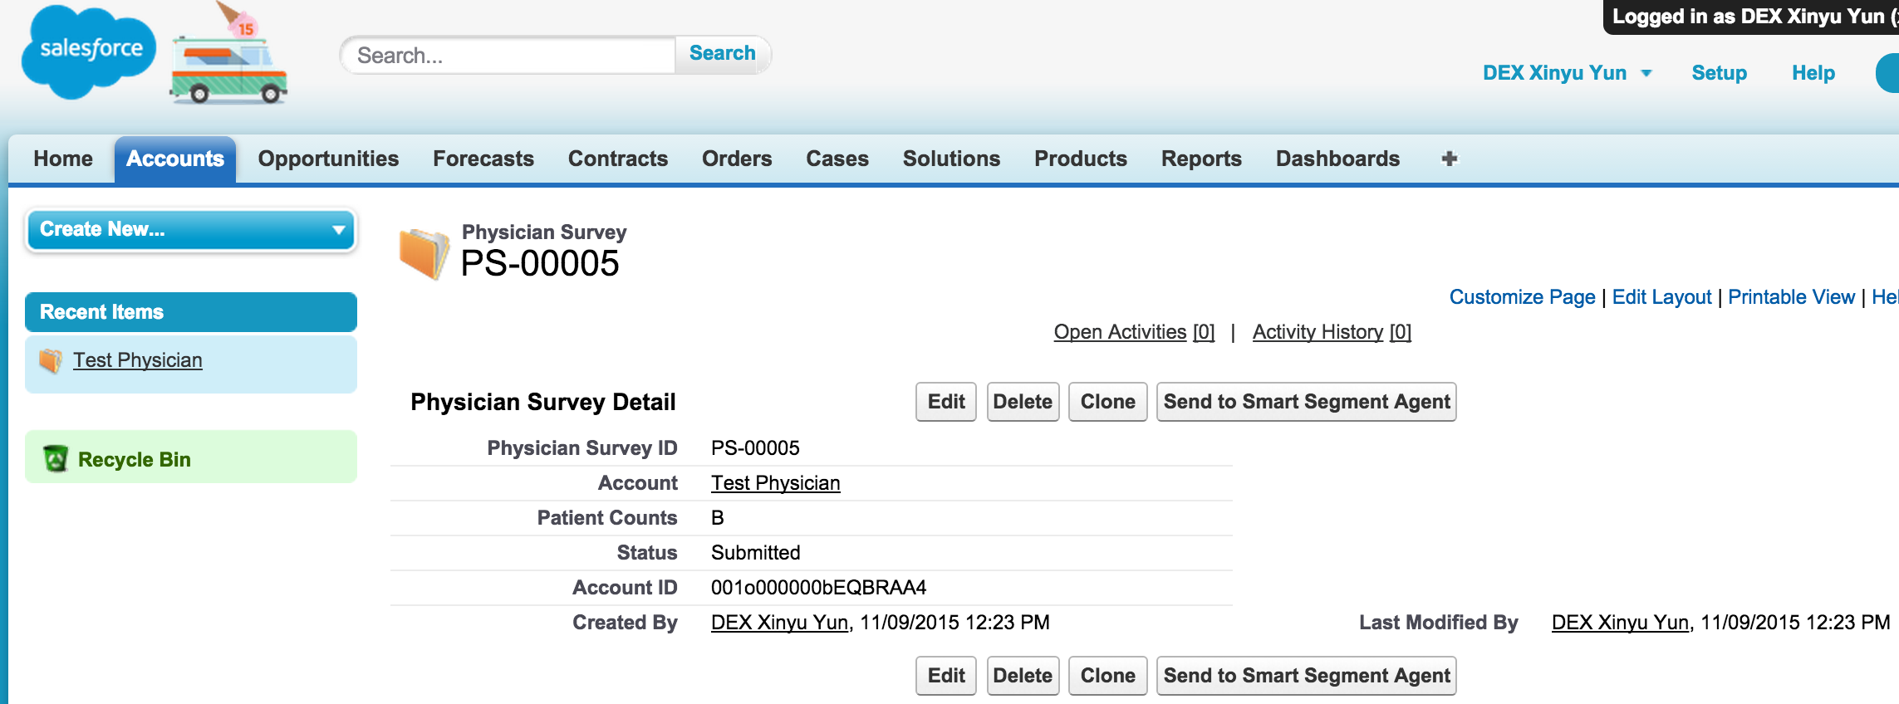
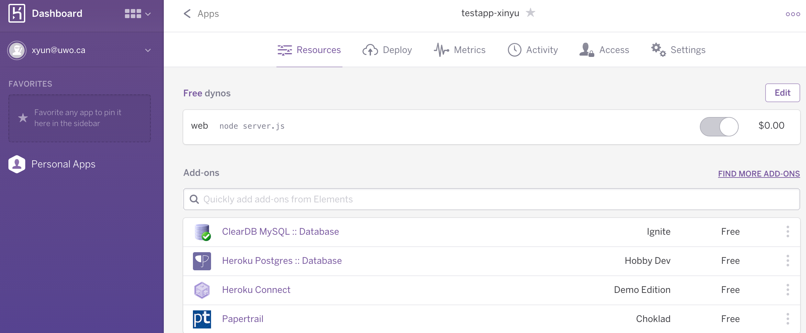
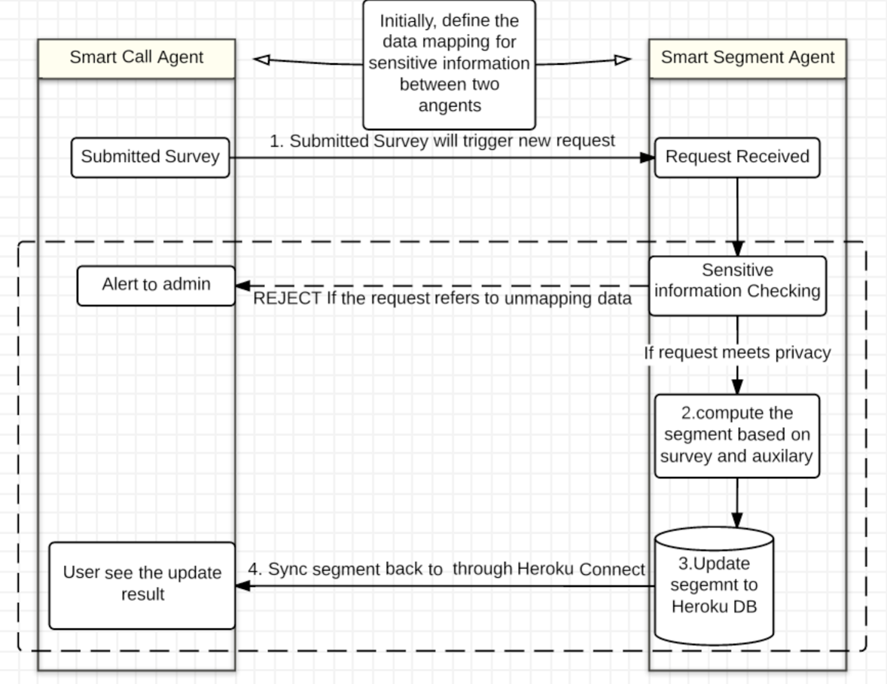
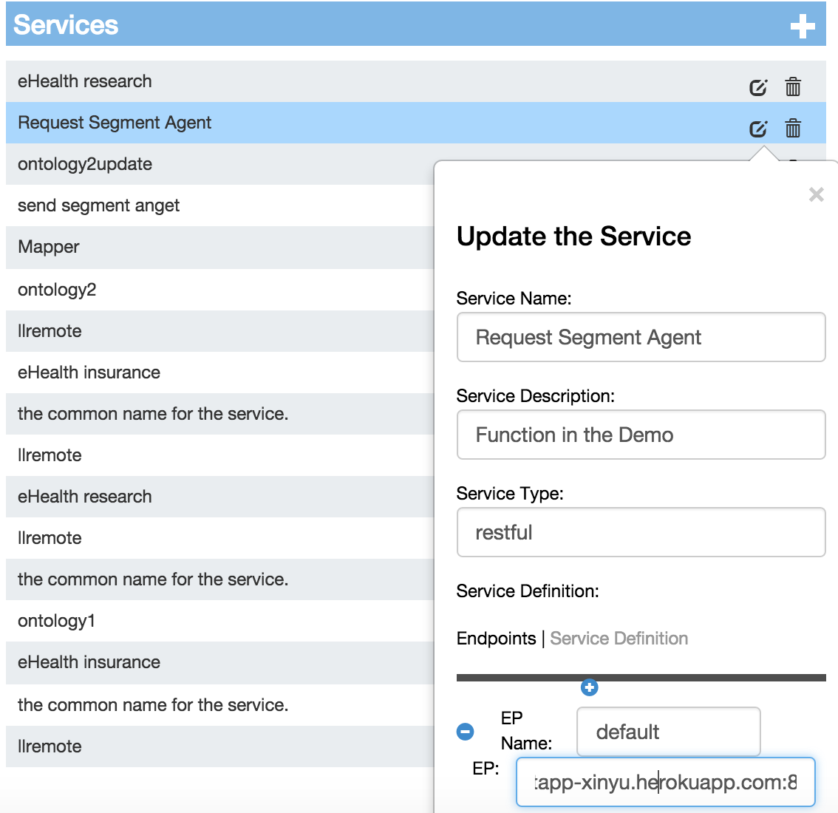
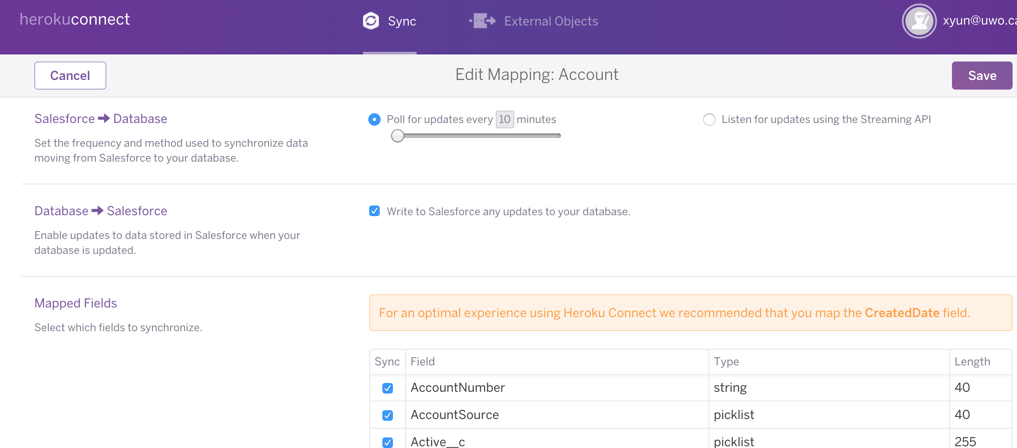
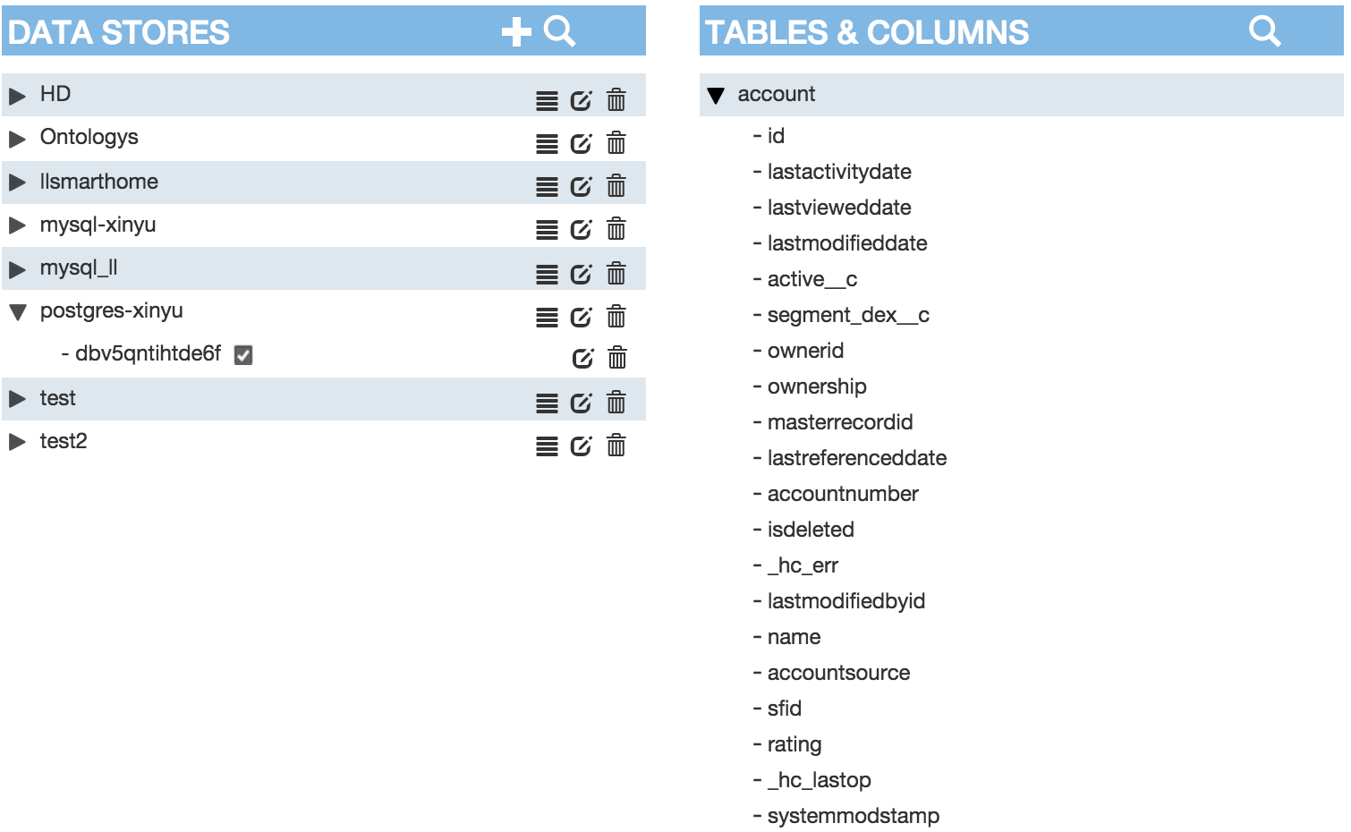
Result and Validation - DEMO Description
ECE9607 - Xinyu Yun

Slide 9
Conclusion
CLM scenario design in CDS with DEX + Heroku +Node.js
Interaction Protocol Pattern
Future Wrok
Enrich the CLM features through ‘smart object’ pattern in CDS
Extend the computation capability of current system through CDS architecture
Enhance the protocol design with negotiation process and privacy concerns
ECE9607 - Xinyu Yun

Slide 10
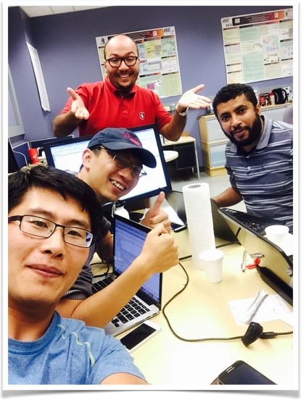

Thanks for the team!
ECE9607 - Xinyu Yun

